Slide 1
Object-Oriented Programming
Object-oriented programming (OOP) is a programming paradigm based on the concept of "objects", which can contain data and code. The data is in the form of fields (often known as attributes or properties), and the code is in the form of procedures (often known as methods).
Source: https://en.wikipedia.org/wiki/Object-oriented_programming

Slide 2
Reading
Read section II and III of the paper “Has the Object-Oriented Paradigm Kept Its Promise?”
lutzhamel.github.io/CSC493/docs/OOPP.pdf
If you are interested, take a peek at Bertrand Meyer’s classic “Object-Oriented Software Construction”. Of particular interest is Section D
lutzhamel.github.io/CSC493/docs/OOSC.pdf

Slide 3
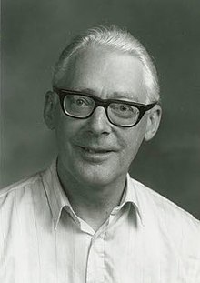
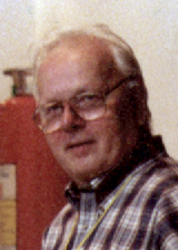

Origins of OOP
Ole-Johan Dahl, Professor Computer Science, 1931-2002
Kristen Nygaard, Computer Scientist, 1926-2002
Simula is a language designed to solve problems in simulations
Introduced objects, classes, inheritance and subclasses, and featured garbage collection.
Inspired by the observation that simulations become more robust when object state and behavior are bundled
Considered to be the first truly object-oriented programming language.
Developed in the 1960’s

Slide 4


Origins of OOP
Dr Alan Kay, computer scientist,
1940-
Smalltalk
Influenced by the ideas in Simula and Lisp
Pure OO, “Everything is an object” – even primitive entities like integers
Highly influential because of the pure OO aspect
Other languages make tradeoffs due to performance issues
Developed in the 1970’s
Open-source modern implementation
https://squeak.org/

Slide 5
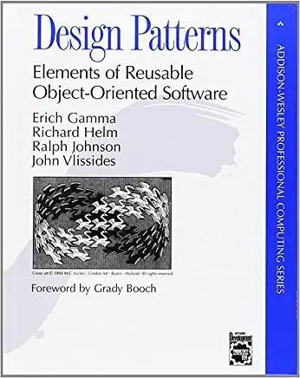
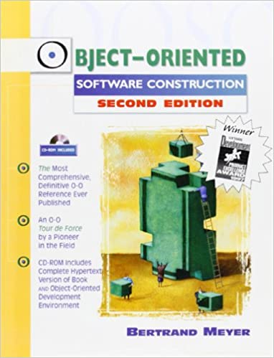
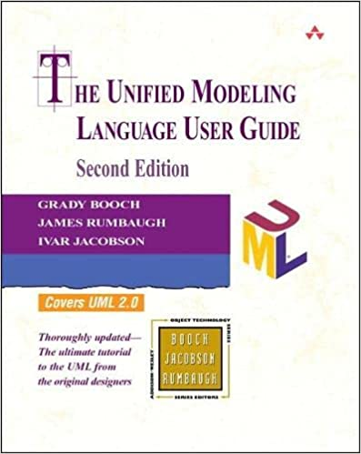
Origins of OOP
Some classics from the “classic” OOP period
Bertrand Meyer, designer of Eiffel, design by contract
Grady Booch, inventor of UML
“Gang of Four”, design patterns were hugely influential on OO architectures and OOP

Slide 6
Object-Oriented Programming
Object-oriented programming (OOP) is a programming paradigm that uses objects and their interactions to design applications and frameworks (e.g. GUI, webservers).
It is based on the concept of "objects", which can contain data and code that manipulates that data and an object identity.
“Classic” OOP languages, such as Java and C++ provide features such as encapsulation, inheritance, and polymorphism to help organize and reuse code.
Encapsulation refers to the practice of keeping an object's internal state and behavior hidden from the outside world, while exposing a public interface.
Inheritance allows one class to inherit properties and methods from a parent class.
Polymorphism allows objects of different classes to be treated as objects of a common superclass.

Slide 7
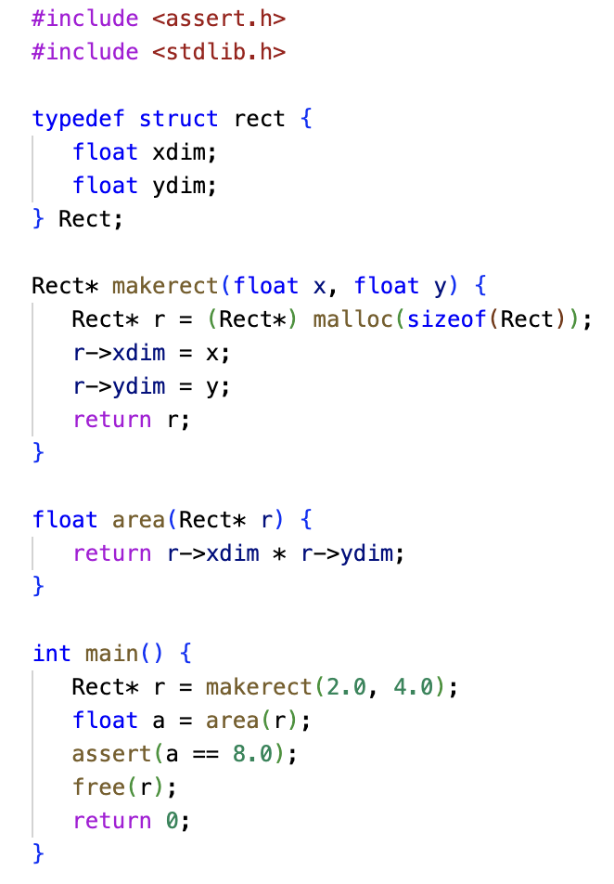
Object Identity
In non-OOP setting objects only have external identity (reference)
Consider the C code on the left – objects/members are only accessed via external identity
This changes in the OOP setting where member functions can refer to the object they belong to via an “internal” identity
ln007/rect.c

Slide 8
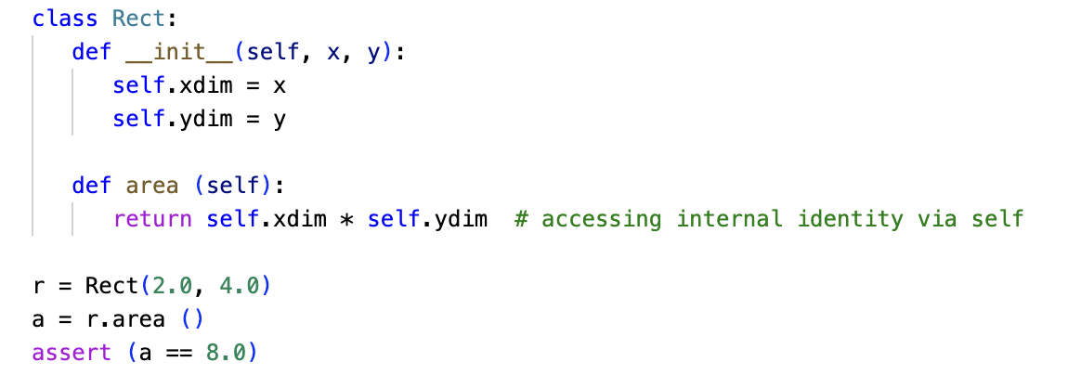
Object Identity – OOP
In Python ”self” refers to the internal object identity
Here we see that the area function access members “internally”.
ln007/rect.py

Slide 9
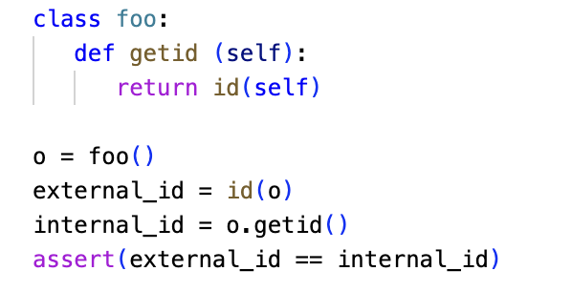
Object Identity – OOP
External object identity and internal object identity are the same!
ln007/id.py

Slide 10
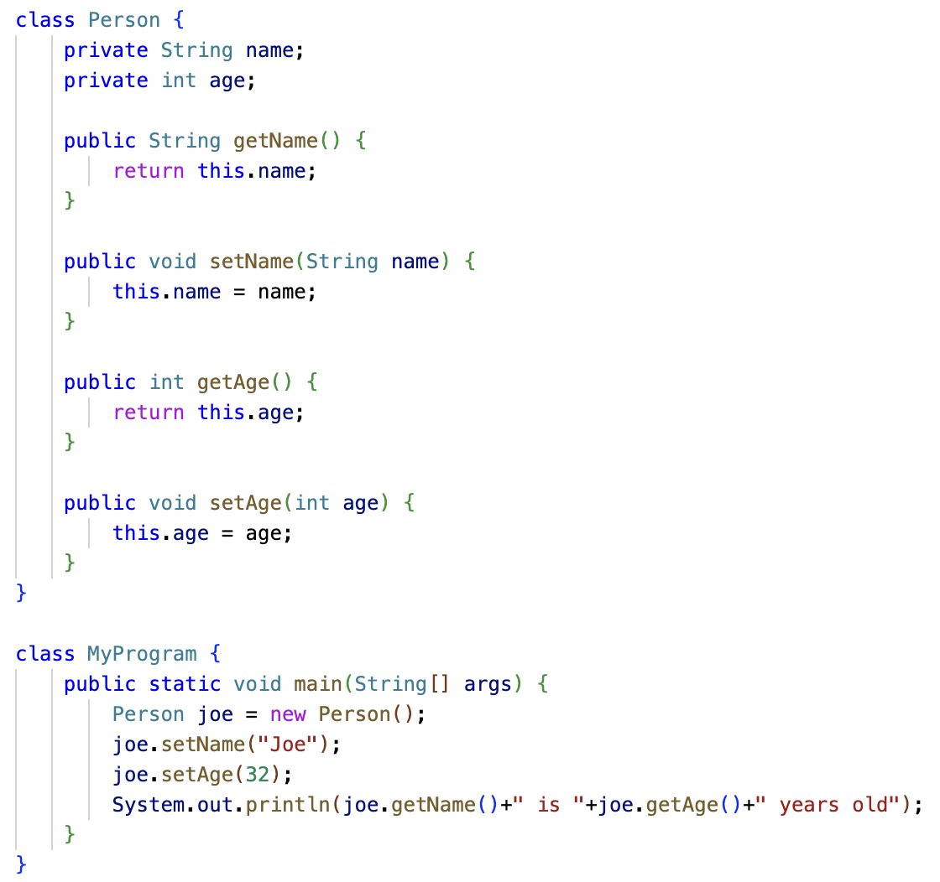
Encapsulation
Data members are “private”
Setter/getter functions
Pros: precise modeling of the notion of “object”
Cons:
Cluttering of public interface with trivial setter/getter functions
Private members are not available to derived classes, which is strange because derived objects own this attribute
To solve this yet another access attribute: protected
ln007/person.java

Slide 11
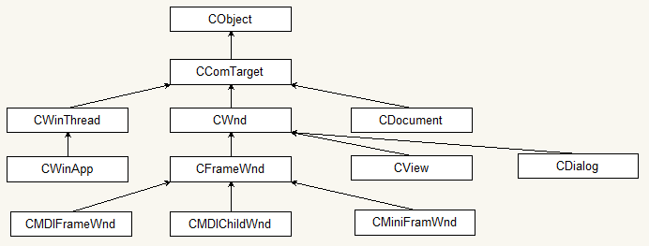
Inheritance
Inheritance is one of the core concepts of object-oriented programming (OOP) languages.
It is a mechanism where you can derive a class from another class for a hierarchy of classes that share a set of attributes and methods.
In statically typed languages like C++/Java it allows for precise modeling of the perceived inheritance relation (is-a) of objects
Partial hierarchy of the Microsoft Foundation Classes (MFC)
Image source: https://commons.wikimedia.org/wiki/File:MFC_hierarchy.png

Slide 12
Subtype Polymorphism
Subtype polymorphism is a feature in object-oriented programming (OOP) in which a subclass or derived class can be used in place of its superclass or base class.
This means that an object of a subclass can be treated as an object of its superclass, and it will respond to the same methods and properties as an object of the superclass.
This allows for more flexibility and reusability in code, as objects can be treated generically and interchangeably based on their common base class(es), rather than having to be treated as specific instances of a class.

Slide 13
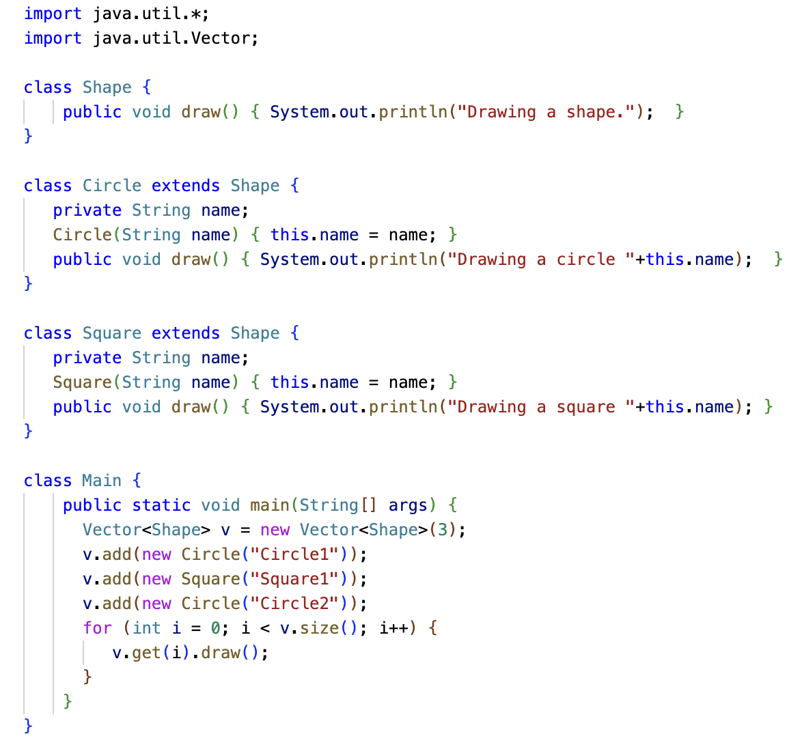
Subtype Polymorphism
Circle < Shape
Square < Shape
Generic Shape Container
Adding specific Shapes
ln007/subpoly.java
Dynamic dispatching to call the correct draw() method

Slide 14
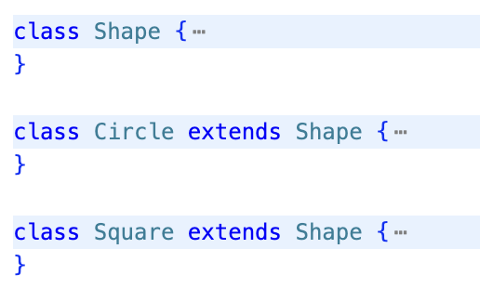
OOP – Foundations
Objects of type Shape
Shape
Circle
Square
Objects of type Circle
Objects of type Square
A class defines a type
A type is a set of values
The values of a type defined by a class are the objects that can be instantiated from that class, e.g.
new Circle()

Slide 15
OOP – Foundations
Shape
Circle
Square
From our class hierarchy we have
Circle < Shape
Square < Shape
From our interpretation of subtypes as subsets we have
Every Circle is a Shape, and every Square is a Shape; green arrows, widening conversion
But not every Shape is either a Circle or a Square; red arrows, narrowing conversion

Slide 16
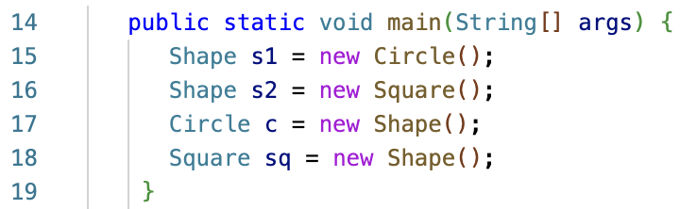
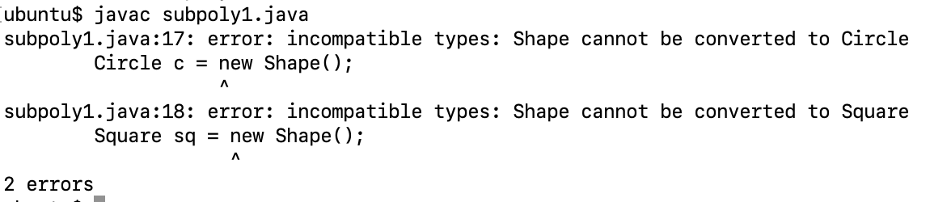
OOP – Foundations
Shape
Circle
Square

Slide 17
OOP – Subtype Polymorphism
Now that we have looked at the set theoretic foundations of OOP let’s take another look at subtype polymorphism
In particular, the idea of dynamic dispatch which makes this so extremely useful

Slide 18
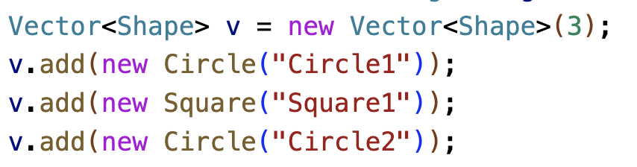
OOP – Subtype Polymorphism
We will use the example from before: create a list of circles and squares and then have each object on the list draw itself.
Caveat: in statically types languages lists/vectors can only have homogeneously type elements
Solution: Use a list/vector where the elements are elements of the base type of our Shape hierarchy BUT we insert our actual Circle and Square objects.
We say that v is a subtype polymorphic list/vector because the objects on the list/vector consist of different subtypes of Shape.

Slide 19
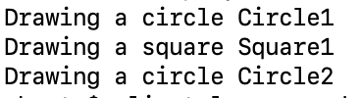
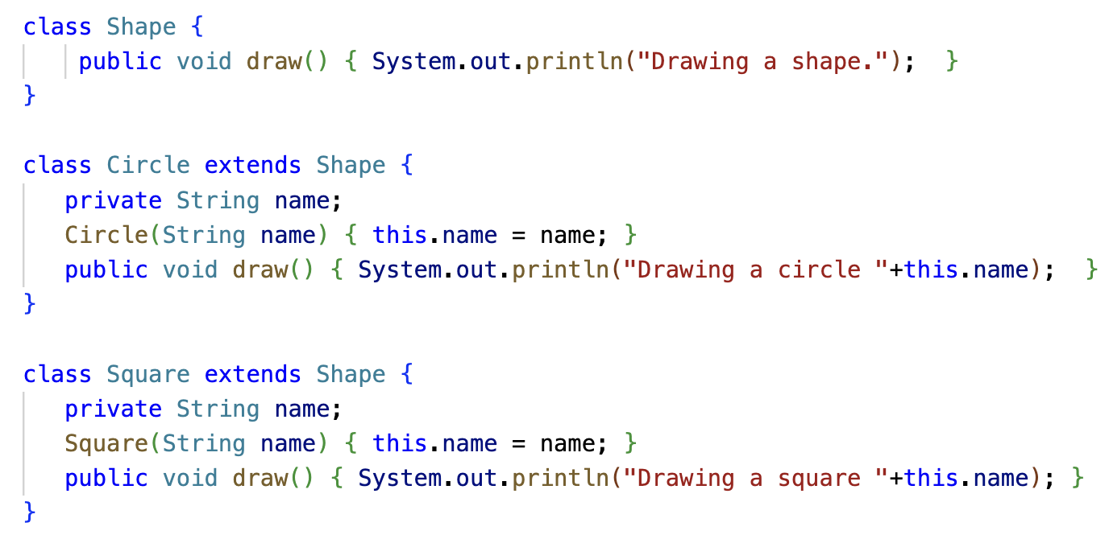
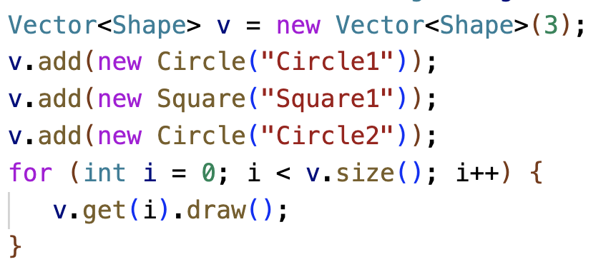
OOP – Subtype Polymorphism
Finally, dynamic dispatch makes this all work.
In the code below we call the draw function on the base class Shape
But what is actually called are the draw functions of the subtypes – dynamic dispatch

Slide 20
OOP – Subtype Polymorphism
Shape
draw()
Shape
draw()
Shape
draw()
Vector<Shape> v =
Circle
“Circle1”
draw()
Square
“Square1”
draw()
Circle
“Circle2”
draw()
Dynamic dispatch realizes when calling the draw function of the base class that a more specific draw function exists and calls that instead of the draw function of the base class.

Slide 21
Dynamically Typed Languages
In dynamically typed languages like Asteroid and Python lists are untyped containers, i.e.
[1,”two”,3.0] is legal
That means, lists in dynamically typed languages are by default polymorphic!
Here, subtype polymorphism with dynamic dispatch is replaced by duck typing,
"If it walks like a duck and it quacks like a duck, then it must be a duck” – the duck test.
Source: https://en.wikipedia.org/wiki/Duck_typing

Slide 22
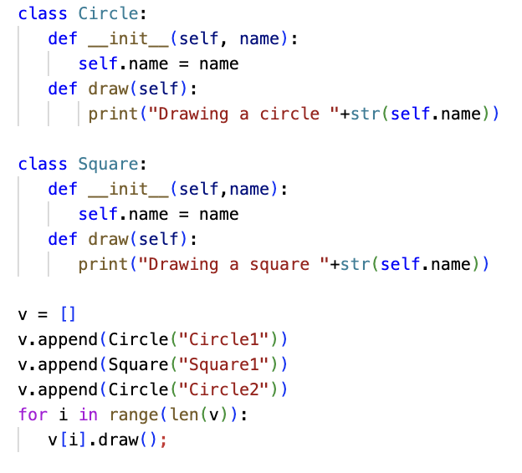
Dynamically Typed Languages
In duck typing the objects on a list have to support the behavior required by the list
However, that behavior does not have to come from a base class!
Consider the shape example written in Python – no base class required – list is polymorphic
ln007/subpoly.py

Slide 23
OOP – Duck Typing
Circle
“Circle1”
draw()
Square
“Square1”
draw()
Circle
“Circle2”
draw()
v =
Duck typing simply assumes that the required functions are present at runtime.

Slide 24
OOP -- Criticisms
“Classic” OOP is increasingly coming under scrutiny
More modern approaches try to address this

Slide 25
Inheritance
Cons:
Static structure: difficult to evolve with changing software requirements
Aggregation: classes at the leaves inherit ALL of the data members and functions of the preceding classes
Partial hierarchy of the Microsoft Foundation Classes (MFC)
Image source: https://commons.wikimedia.org/wiki/File:MFC_hierarchy.png

Slide 26
Multiple-Inheritance – The Diamond Problem
Briefly:
An ambiguity that arises when two classes B and C inherit from A, and class D inherits from both B and C.
If there is a method in A that B and C have overridden, and D does not override it, then which version of the method does D inherit: that of B, or that of C?
That is: D.foo() – which foo() should be called?
This gets really problematic in deep inheritance structures.
foo()
foo()
foo()

Slide 27
The Diamond Problem
Different languages deal with the diamond problem in different ways
C++ uses a fully qualified syntax
Python uses a class hierarchy linearization algorithm (C3 linearization or MRO) to resolve ambiguities
Java does not support multiple inheritance.
MRO: Method Resolution Order

Slide 28
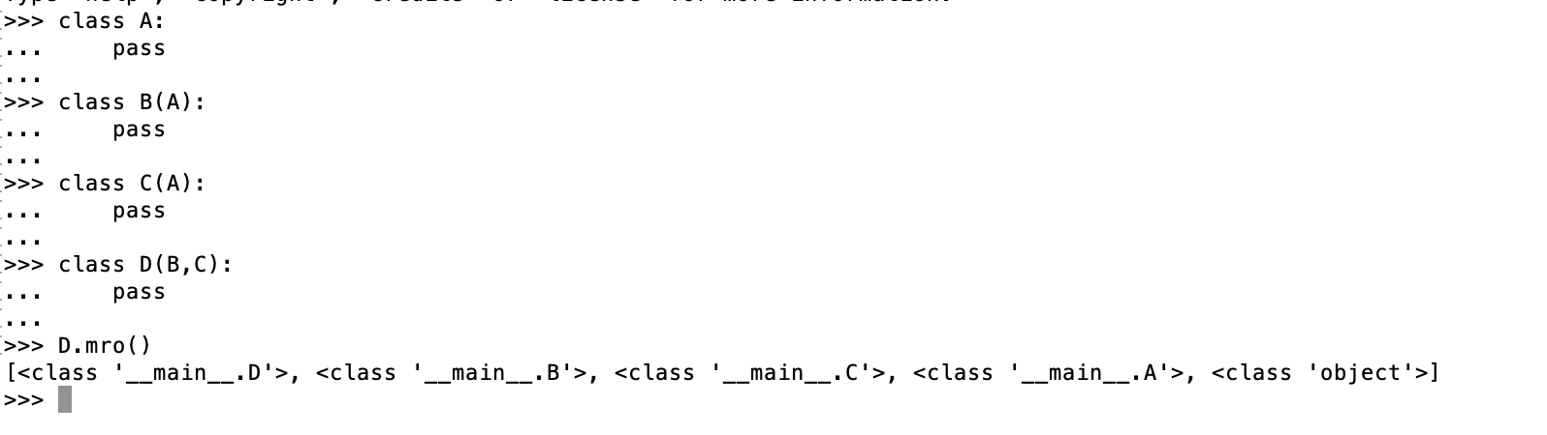
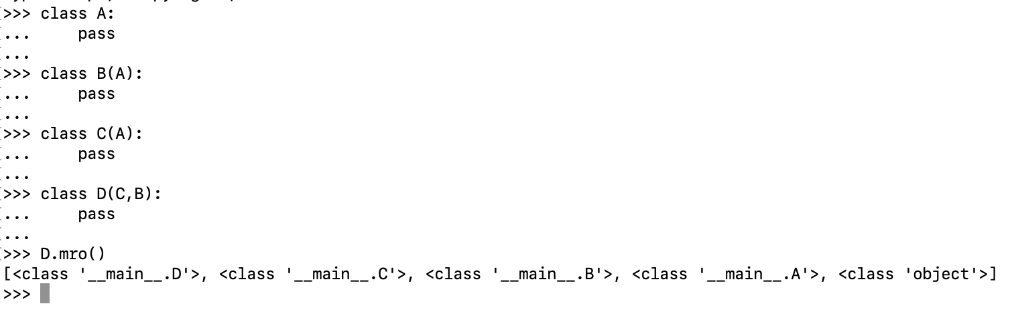
The Diamond Problem
In Python, the method that is called depends on the order of your inheritance specification !?!

Slide 29
Other Criticisms
Joe Armstrong, the principal inventor of Erlang, is quoted as saying: The problem with object-oriented languages is they've got all this implicit environment that they carry around with them. You wanted a banana but what you got was a gorilla holding the banana and the entire jungle.
Luca Cardelli claims that OOP code is "intrinsically less efficient" than procedural code, that OOP can take longer to compile, and that OOP languages have "extremely poor modularity properties with respect to class extension and modification” and tend to be extremely complex.
Alexander Stepanov (main author of the C++ STL) compares object orientation unfavorably to generic programming: I find OOP philosophically unsound. It claims that everything is an object. Even if it is true, it is not very interesting — saying that everything is an object is saying nothing at all.
Eric S. Raymond, a Unix programmer and open-source software advocate, has been critical of claims that present object-oriented programming as the "One True Solution", and has written that object-oriented programming languages tend to encourage thickly layered programs that destroy transparency.
Rob Pike, a programmer involved in the creation of UTF-8 and Go, has called object-oriented programming "the Roman numerals of computing” and cites an instance of a Java professor whose "idiomatic" solution to a problem was to create six new classes, rather than to simply use a lookup table.

Slide 30
On the other Hand…
OO approaches work extremely well for GUI and related frameworks.
Like everything else, OOP is just a tool to be used in situations where it makes sense,
Bundling behavior with state is in itself not a bad idea,
Trying to see every programming problem through this lens is…

